Slide 1
Centres of Excellence
Supporting career and post-secondary readiness through sector-connected learning opportunities
Mike Cusack Ransford Lockhart
Department of Education and Early Childhood Development
New Brunswick, Canada

Slide 2
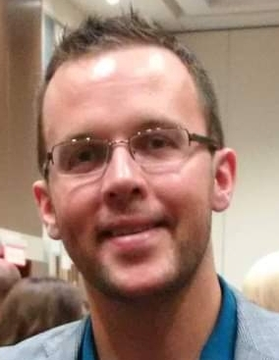
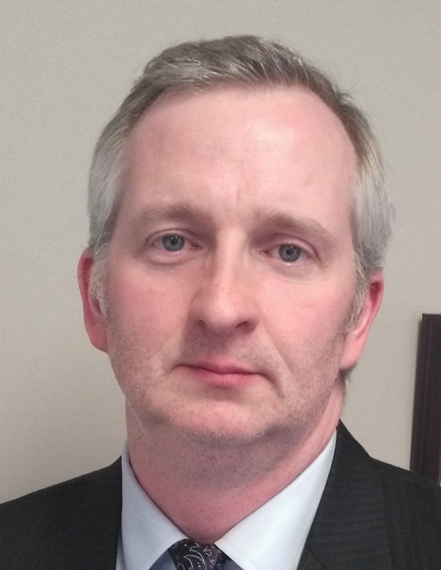
About us…
Ransford Lockhart
Mike Cusack
Learning Specialist
Strategic Partnerships
Experiential Learning
Centre of Excellence Co-Lead
Learning Specialist
Online/Distance Learning
Cooperative Education
Centre of Excellence Co-Lead

Slide 3
New Brunswick // Canada
Overview
Population 780,000
50/50 Urban/Rural split
~2/3 English ~1/3 French
~4% Indigenous population
Canada’s only officially bilingual province
Anglophone and Francophone school systems
Anglo: 205 schools, including 49 High Schools
System-wide commitment to inclusion

Slide 4
Challenges to New Brunswick
Challenges to
New Brunswick
Population
Oldest population in Canada
Young people leaving New Brunswick
Seeking to grow population through immigration
Workforce
Need to increase innovation and productivity in the work force
Labour shortages in key sectors
120,000 job openings in the next 10 years

Slide 5
Challenges
in Education
Teacher and Students
Increasing demands on teachers
Low levels of student engagement
Equitable access to opportunities for all schools in the province
Partners
Working with partners in business and industry
Confined to old ways of thinking
Difficult to scale beyond individual schools/locations

Slide 6
Meeting the challenges together
Increase student and teacher focus on career-connected learning.
Make it easier for teachers and outside experts to connect and collaborate.
Show students they can make a living, and a life, in New Brunswick.
Make learning more authentic and engaging by connecting it to real-world opportunities.
Remove barriers that make it difficult for teachers to include outside experts in their teaching.
Get students excited about opportunities they didn’t know existed within the province.

Slide 7
System changes that support career education
Policy updates
Policy 316 - Graduation Requirements
Policy 703 - Experiential Learning
Policy
Options for credit
Personal interest courses, dual-credit, prior learning, …
Essential Skills Program // work-ready learning
Pathways
Career connected learning
Choice
Enhanced coop programs – e.g. Long-Term Care, Early Childhood
Virtual Mentorship Coop programs
Supports
Supports
Added Strategic Partnership unit to onboard partners
Added Experiential Learning Lead for each school district

Slide 9
Why these particular Centres?
Cross-Curricular
Opportunities for application across K-12
Allows for practical application of core learning
Growth sectors with labour market opportunity
Labour Market Information
Leverages to other initiatives (e.g. post-secondary digital health centre)
Partners interested in collaborating
Industry, post-secondary, community, and government partner interest
Partner ability to support project goals
Foundational areas
Areas that capture public attention and generate a lot of conversation
Knowledge in these areas makes for better informed citizens

Slide 10
Centre of Excellence Structure
A single point of access for schools and partners
Sector Partners
Centre of Excellence
Centre of Excellence
Centre Lead
Supports
Website
Post-Secondary Education
K-12 School System
Other Government Departments
Other Partners
and Agencies

Slide 11
What makes a Centre of Excellence possible?
Centre Staff (people)
Full-time lead for each Centre (teachers, partly funded by partners)
Supports of EECD and districts with curriculum support, leads, and other educators
Access to Expertise (knowledge)
Industry partners willing to provide expertise and support
Participation and access to partner knowledge, staff, and possibly facilities and equipment
Operational Supports (funding)
General operating costs
Consumables (e.g., kits, materials)
Event costs (e.g., student site visits)
Teacher Professional Learning time/travel

Slide 12
COE Learning and Engagement Model for K-12
Career Readiness
Direct sector-specific experiential learning; coop placements, mentoring, volunteering, capstone projects
Active Exploration
Deeper engagement in sector-specific experiences; problem and project-based learning, site visits, applied research
Foundational Awareness
Career Readiness
Introducing concepts, classroom connected supports: speakers, activities, virtual tours, research
Active Exploration
Foundational Awareness
Curriculum Focused
Builds across K-12 curriculum outcomes.
Augments existing curriculum using examples found in real-world practice
EECD’s 10-Year Education Plan Global competencies, SDGs, Essential Skills
Curriculum

Slide 13
What it looks like in action
Career Readiness
Long-Term Care Coop Partnered with LTC sites to combine coop and an online course for work-ready opportunity
Experiential Learning opportunities Offsite, student-driven, 1-3 day placements in area of interest
Students as professionals Inviting students to participate in professional learning opportunities (e.g. virtual conferences)
Active Exploration
Wind Energy Challenge Students test windmill blades they have designed to determine characteristics of peak performance
Health Care 110 Developing new course for HS students that explores skills and careers across the health sector
IDEA Market Middle school entrepreneurship market designed to take students through stages from idea development to final product
Foundational Awareness
Nuclear Science Week Live and on-demand sessions with experts in nuclear science, energy, and medicine
Soft-Skills Training Modules A series of short, self-paced, modules to enhance awareness of work-ready skills
Handwashing Training for K-2 Post-secondary nursing student developed materials for teacher-led activities

Slide 14
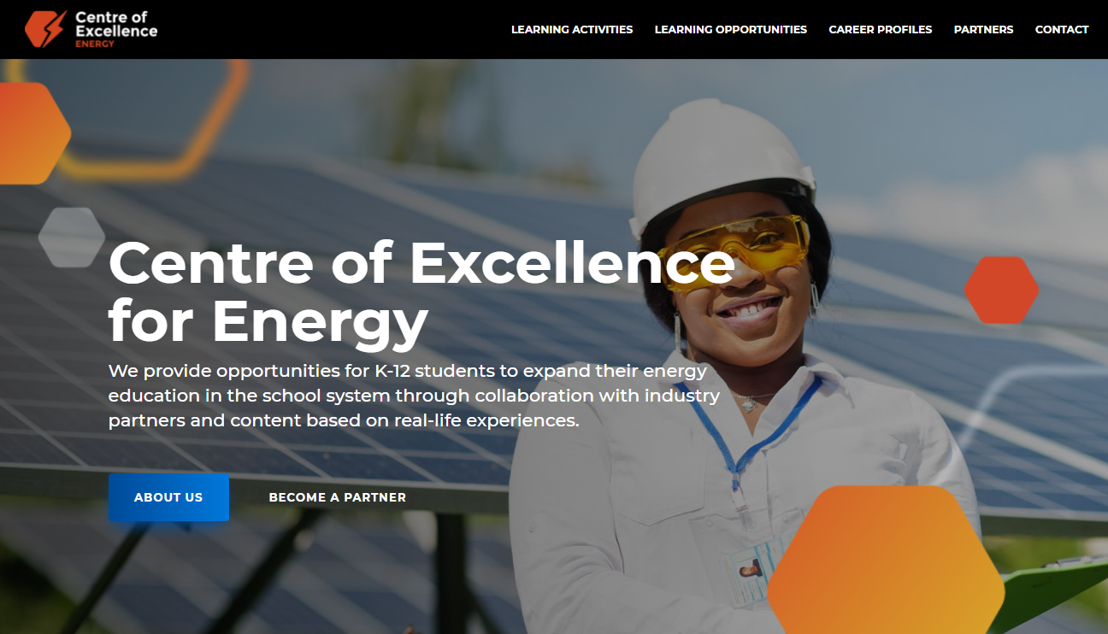
Centre of Excellence Website https://centresofexcellencenb.ca/
COE Energy – Sep ‘21
COE Entrepreneurship – Dec ‘21
COE Health – Dec ‘21
COE Digital Economy – April ’22
Sites will evolve as sections are added

Slide 15
COE Initiative Timeline
School Semesters
S1 // September – January
S2 // February - June
COE Websites Launch
Partner engagement
Dedicated website launch for each COE
Exploring needs and opportunities
Feedback and Future
Partner recruitment
Ongoing process improvements. Launch of new centres possible.
Seeking dedicated partners for each COE
Internal Development and Planning
Funding / viability
Building internal support and operating model
End of initial phase of confirmed funding
COE Leads Begins
Teacher seconded to serve as full-time lead
Ongoing teacher and partner support
19-20
20-21
21-22 S1
21-22 S2
22-23

Slide 16
How are we measuring success?
NBIRDT
Research Framework
Partner
Objective, external review commissioned through NB Institute for Data, Training, and Research to measure educational success with students.
Satisfaction
Student
Two-year window to determine viability with goal being COEs funded from partner sources.
Achievement
Teacher
Observable measures of educational merit. Improved alignment between student post-secondary goals and measurable actions.
Internal
Engagement
KPIs
Teacher response to COE initiative. Participation in sessions, activities, and opportunities. Use of materials and supports. Willingness to give back and engage COE and partners.
Tracking reach, opportunities created, sessions delivered, website data, user participation, social media engagement

Slide 17
Centres of Excellence
Supporting career and post-secondary readiness through industry-connected learning opportunities
Mike Cusack
Ransford Lockhart
mike.cusack@gnb.ca
ransford.lockhart@gnb.ca
Thank you for your time and attention
Questions?

